Slide 1

MIS 547
Cloud Computing

Slide 2

Admin
Assignment 6: Due next Thursday? Due next Sunday?
01
Group Projects
03
Quiz 5: Due Sunday
02
Survey results will be available on D2L
04

Slide 3
Group Projects
Introduction
Your group project this semester is a deep exploration of Machine Learning Operations, otherwise known as MLOps. Given the ever-increasing demand for AI and ML in business operations, this project will serve you as a project or product manager to better align business strategy with technological implementations. If your post-graduation goals are around data analytics, then this project will help you better understand how your models fit into business strategies and architectures, significantly increasing your ability to execute rapid delivery of models.

Slide 4
Group Projects
Directions
Working in teams of 4, you will create a fictitious business case where the implementation of an AI or ML model will solve an important business problem. You’ll discuss the business problem in depth, choose a model that best serves that problem, define the specific task the model will achieve, define the dataset that will be used to train the model, and then implement the full end-to-end architecture using DigitalOcean infrastructure.

Slide 5
Business Problem Examples
Prevent fraudulent registrations on your platform
Make stronger recommendations about products for your customers
Predict next quarter’s revenue given historical data
Etc.
Discuss the business problem in depth:
Why is this problem important?
What will the outcomes be of solving this problem?
Who are the stakeholders? Who might need to sign off on your approach?

Slide 6
Choose a Model that will address the problem
F&A detection → tons of models you can use
Make stronger product recommendations → collaborative filtering, a priori, fptrees
Predict next quarter’s revenue: time series forecasting (ARIMA)
Choose a model that best serves that problem
Why is this model relevant?
What other researchers use this model?
Why do you recommend using this model?

Slide 7
The Task the model will achieve
E.g. classify users into good or bad
Generate 5 product predictions
Forecast 1 month of revenue
Define the specific task the model will achieve:
Give clear details about the task.
Make sure that the model you selected actually delivers on that task.

Slide 8
Define the Dataset
Find an Open Source dataset (Kaggle) or build one of your own.
Provide a data dictionary
Summarize the dataset

Slide 9
Implement a Full end-to-end model
What are the stages in a machine learning model’s lifecycle?
Do together

Slide 10
Midsemester Updates
Due on October 24 (30 points)
The deliverable should be a two to three page update that identifies the following:
Identify the business problem that you are trying to solve through the use of an ML model
Which model you will be using and why
The dataset that you will train your model on
A draft architecture of your final project build
Your next steps, identified roles, identified blockers or obstacles
At this stage in the semester, it would be a good idea to have fully trained your model once; this will help you understand the requirements of this model better. For example, were you able to train it on your local laptop? Did you run out of memory? Did you need more compute resources? If so, what was the minimally viable droplet size that let you fully train your model? If you used a Jupyter notebook to train your model, how can you think about refactoring that model code to be run as a service on a virtual machine. Have you tried containerizing it?
Grading rubric: https://d2l.arizona.edu/d2l/le/content/1477645/viewContent/17438915/View

Slide 11
AGENDA
What’s covered in this lecture
Agenda
Cloud Native Computing
Serverless

Slide 12
Lecture 11
Cloud Native Computing

Slide 13
Serverless Computing

Slide 14
What is Serverless Computing?
A deployment architecture where servers are not explicitly provisioned by the developer.
Code is instead executed based on events (defined by the developer) that are triggered.
Triggers are events:
E.g., when an HTTP POST request is sent to an API, a new line is written to a file

Slide 15
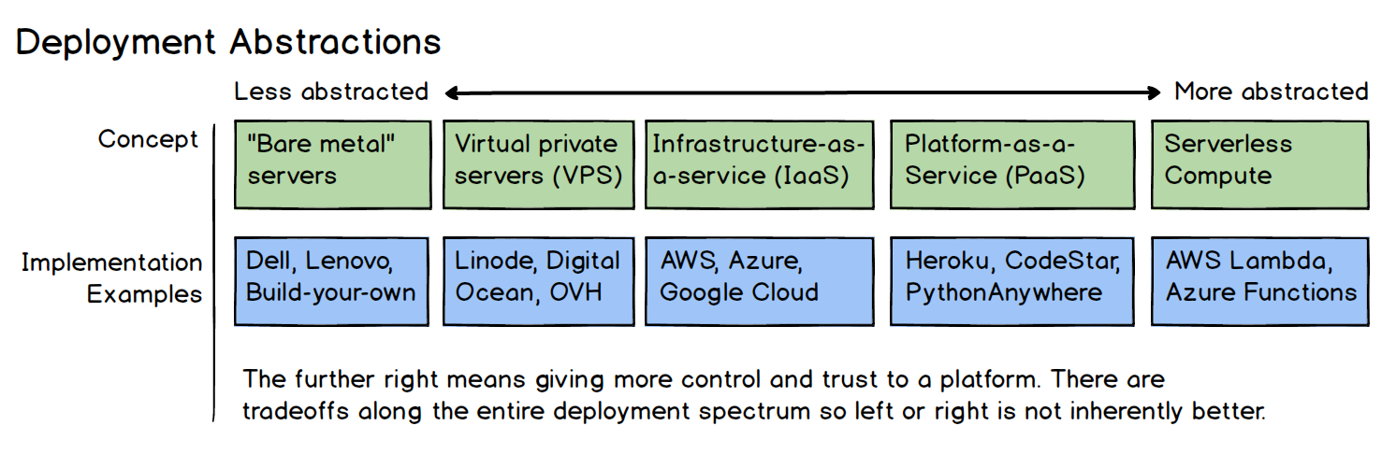
How can code by executed without servers?
Servers still exist but they are abstracted away from the developer and handled by a cloud
Source: Full Stack Python

Slide 16
Kinds of Serverless Architectures
Backend as a Service (BaaS)
Original way of thinking of serverless
Applications that significantly or fully incorporate third-party, cloud-hosted applications and services for server-side logic and state
e.g., Mobile apps using cloud-accessible databases, authentication, etc.
Functions as a Service (FaaS)
Server-side logic is written by the developer, but run in stateless compute containers
Event-triggered, ephemeral, fully managed by third party.

Slide 17
Functions as a Service
FaaS is about running backend code without managing your own server systems or your own long-lived server application.
We upload the code for our function to the FaaS provider, and the provider does everything else necessary for provisioning resources, instantiating VMs, managing processes, etc.
Horizontal scaling is completely automatic, elastic, managed by the provider.
No cluster or VM management required

Slide 18
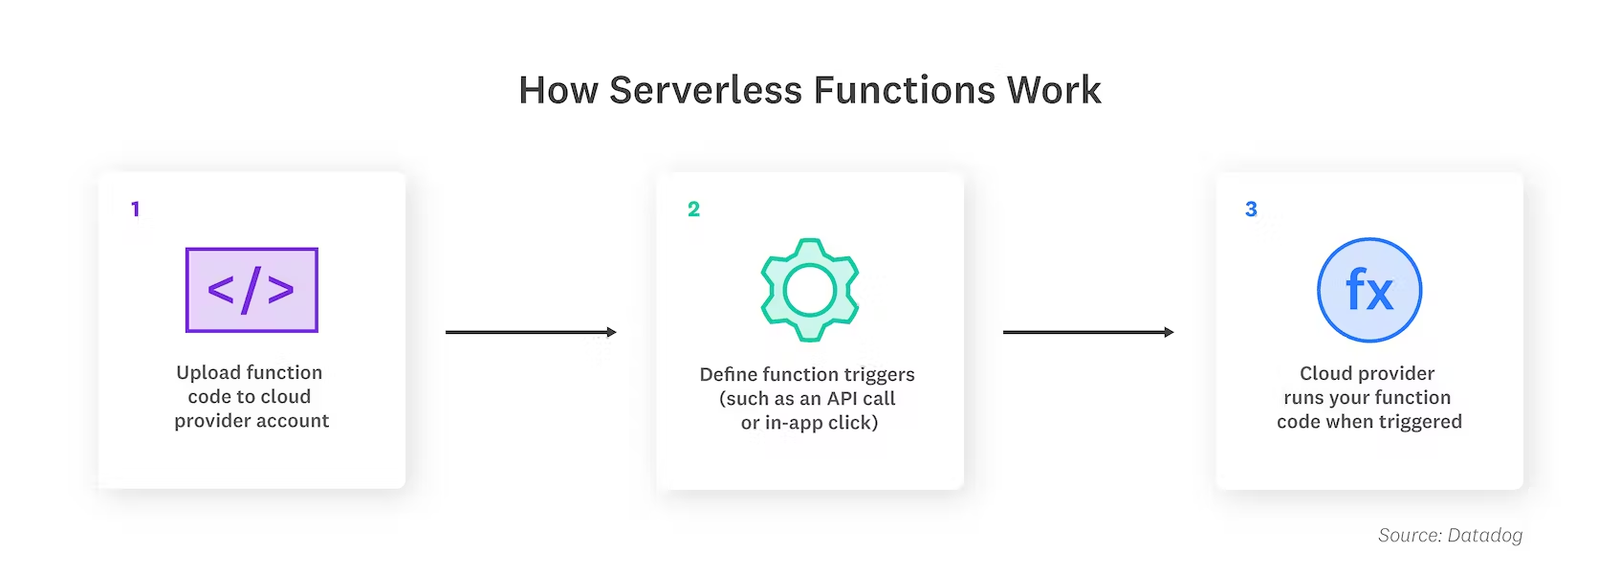
Functions as a Service
Source: DataDog

Slide 19
Serverless Terms
Invocation: a single execution of a function
Duration: the time it takes for a function to execute
Cold Start: latency that occurs when a function is triggered for the first time or after a period of inactivity
Concurrency limit: the number of function instances that can run simultaneously, as determined by the cloud provider
Timeout: the amount of time a function is allowed to run before termination

Slide 20




FaaS Implementations
AWS Lambda
Azure Functions
Google Cloud Functions
DigitalOcean Functions

Slide 21
Event-Based architecture
Functions are meant to be small and focused
Common use cases:
Sending emails
Starting backup
Order processing
Task scheduling
Functions are triggered by event types defined by the provider
E.g., S3 file updates, time (scheduled tasks), inbound HTTP requests

Slide 22
State
Significant restrictions when it comes to local state
Data stored in memory or written to local disk
No guarantee that state is persisted across multiple invocations
FaaS functions are often described as stateless
Any state of a FaaS function that is required to be persistent needs to be externalized outside of the FaaS function instance

Slide 23
Cold Starts
Cold starts ranges from a few milliseconds to several seconds
Warm start: reusing an instance of a Lambda function and its host container from a previous event
Cold start: creating a new container instance, starting the function host process, etc.
Cold start latency depends on language, # libraries, configuration, VPC resources, etc.
Frequency:
process 10 50ms events per second, cold start every 100,000 events or so
Process 1 event per hour, cold start every event (Lambda instances are retired after being inactive for a couple minutes)

Slide 24
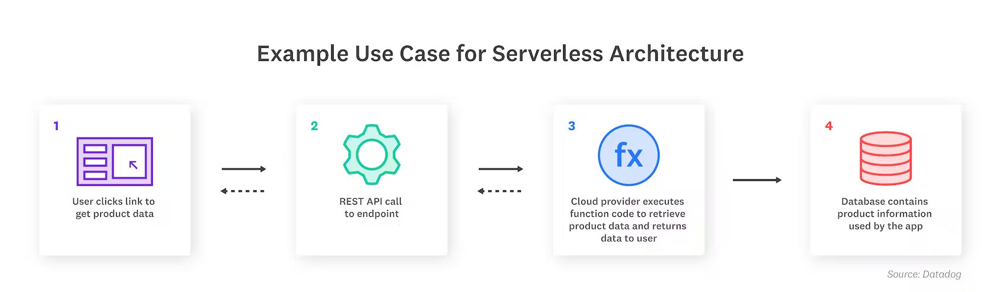
Serverless Use Cases
Source: DataDog
Trigger-based tasks (user signs up on website: triggers database change, triggers welcome email)
Asynchronous processing: rendering product information or transcoding video after upload
Security checks: invoke a function to scan a new container in production

Slide 25
Serverless Use Cases, Cont.
Web applications: serve front-end code via S3, backend via Lambda
Web and mobile backends: use API Gateway to communicate with backend.
Data processing: streaming data ETL tasks
Parallelized computing tasks
IoT workloads: processing data generated by physical IoT devices

Slide 26
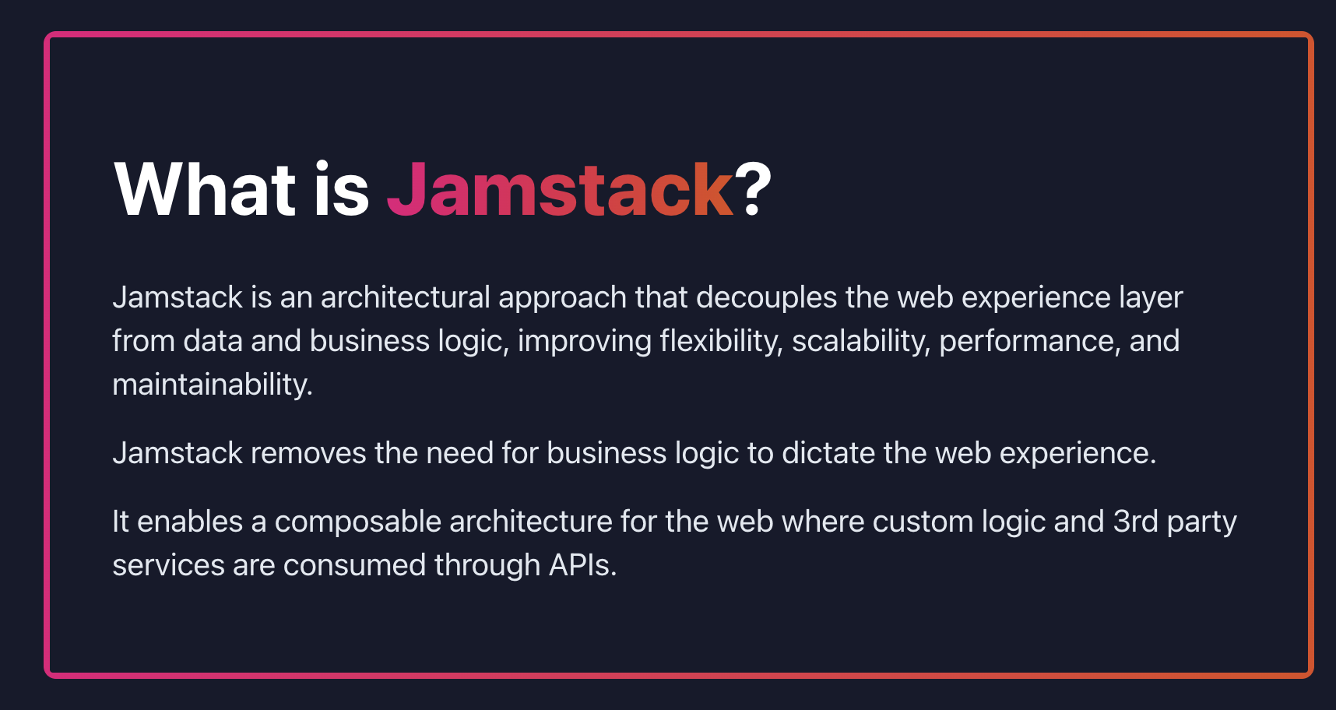
Jamstack

Slide 27
JAMSTACK
JavaScript
API
Markup
Application logic resides on the client side

Slide 28
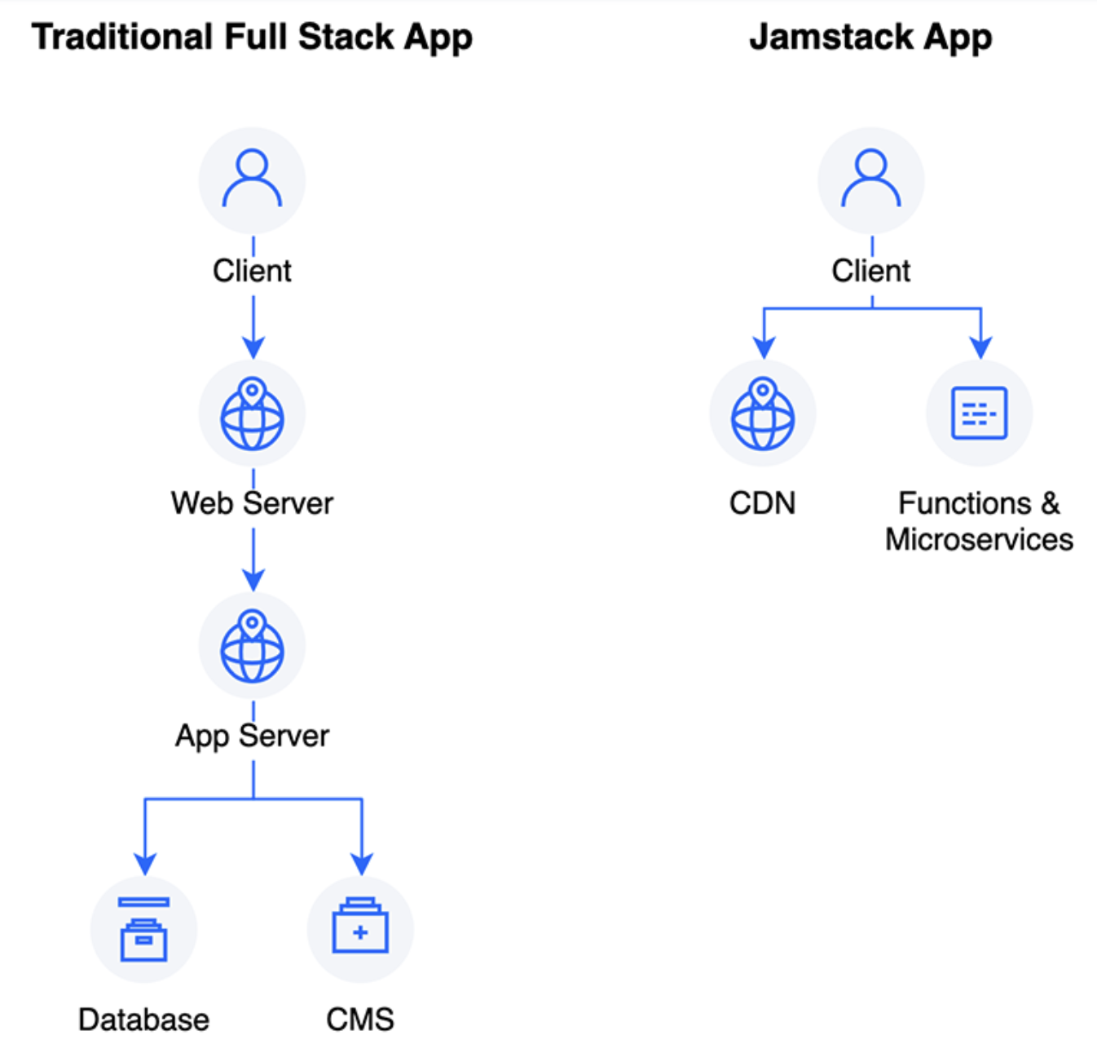
JAMSTACK
Rather than a three-tier web architecture
(presentation, application, data), JAMstack relies on CDNs and serverless technologies to provide the functionality required to serve a website.
Source: DigitalOcean Documentation

Slide 29
Static Site Generators
Software engines that use text input files (markdown, AsciiDoc, reStructuredText, JSON) to generate static web pages.
Do not require a backend after site generation
First-class citizens on content delivery networks
Used for product pages, news articles, software docs, blogs, etc.

Slide 30
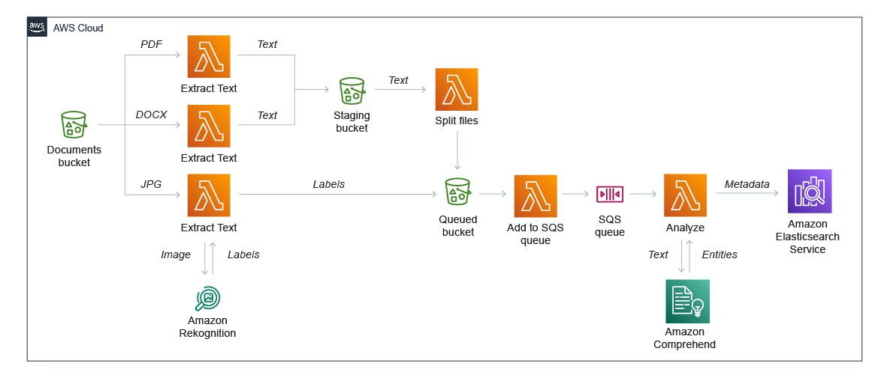
Serverless Use Cases: Event Ingestion

Slide 31
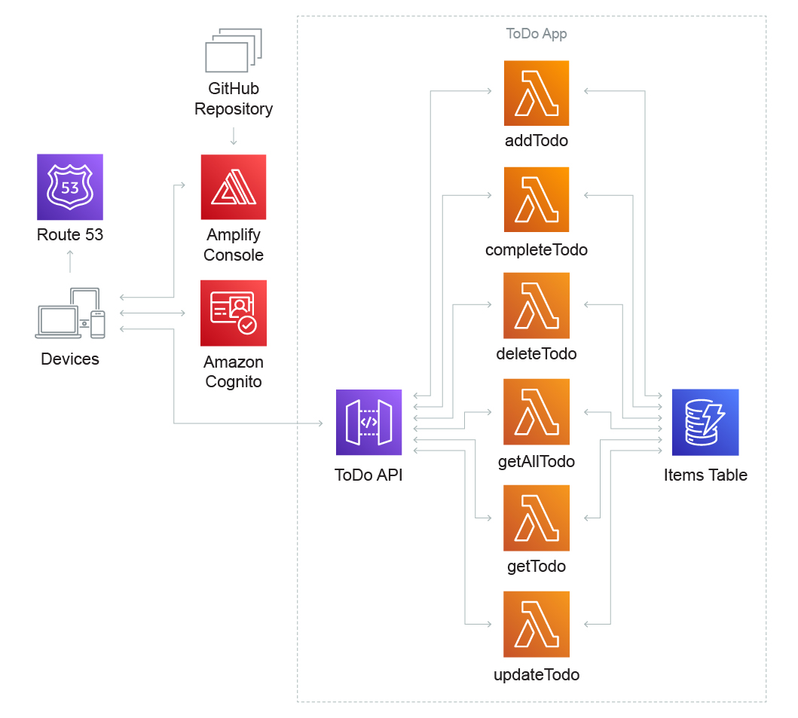
Serverless Use Cases: Web Applications
Amplify: PaaS
Cognito: IaM

Slide 32
Serverless Frameworks
Libraries and frameworks provide reusable code to handle common or tedious tasks
serverless.com
Serverless Framework: makes working with AWS API Gateway and Lambda easier
Cross-vendor tooling abstraction
AWS Serverless Application Model
Zappa: https://github.com/Miserlou/Zappa
AWS Chalice: https://aws.github.io/chalice/index

Slide 33
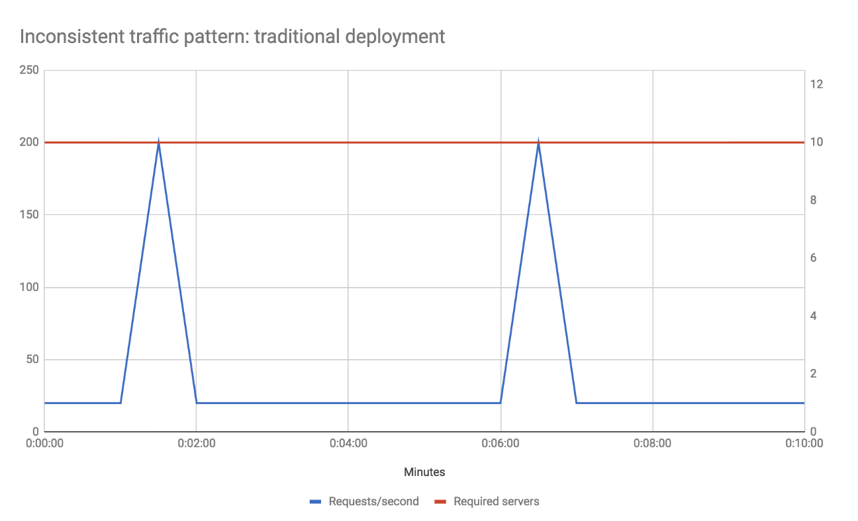
Serverless Benefits
Reduced operational cost
Infrastructure costs
Labor costs
Compute: free tier provided by some FaaS providers
Run a server application that only processes one request per minute, 50ms to process each request
Mean CPU usage over an our is .1%
1,000 other similar applications can share the same machine
Source: https://martinfowler.com/articles/serverless.html

Slide 34
Serverless Benefits
Scaling: since scaling is performed by the provider on every event, you no longer need to think about the question of how many concurrent requests you can handle
Zero systems administration
Time to market and continuous experimentation
Greener computing?

Slide 35
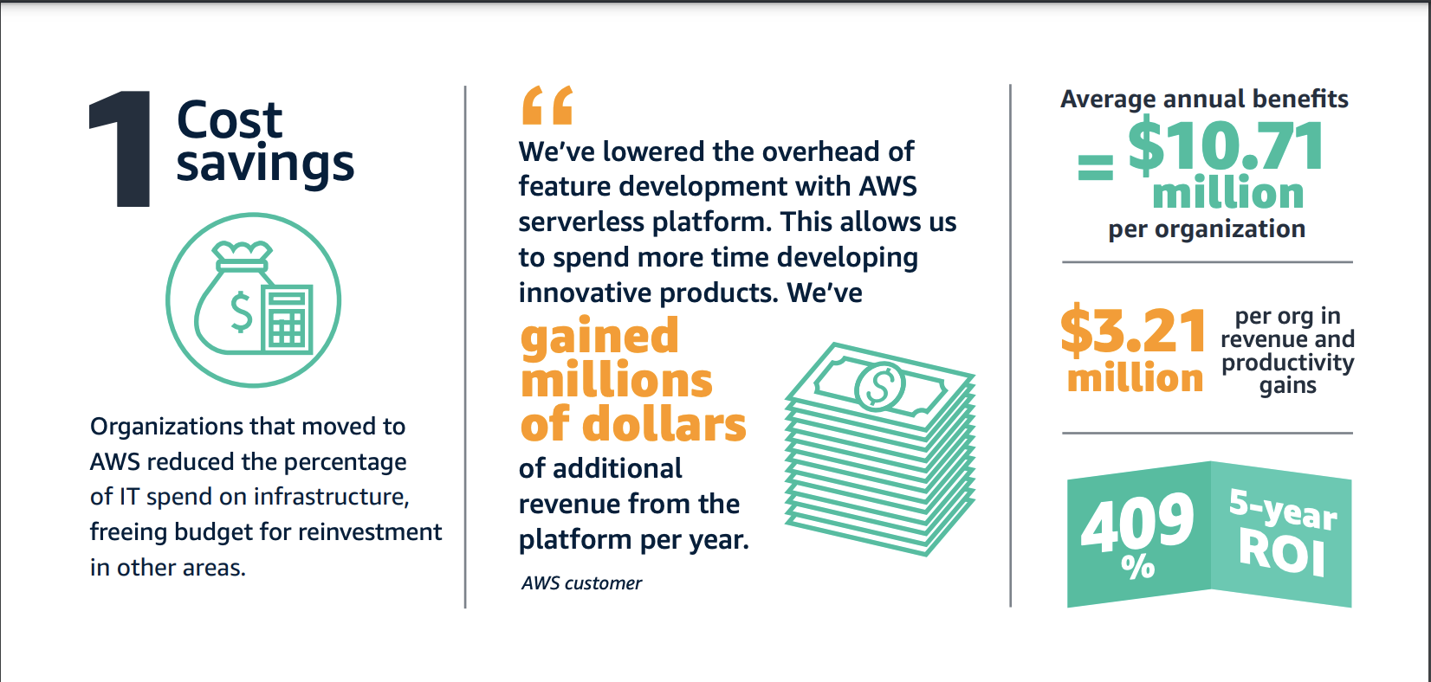
Serverless Benefits: AWS Reporting

Slide 36
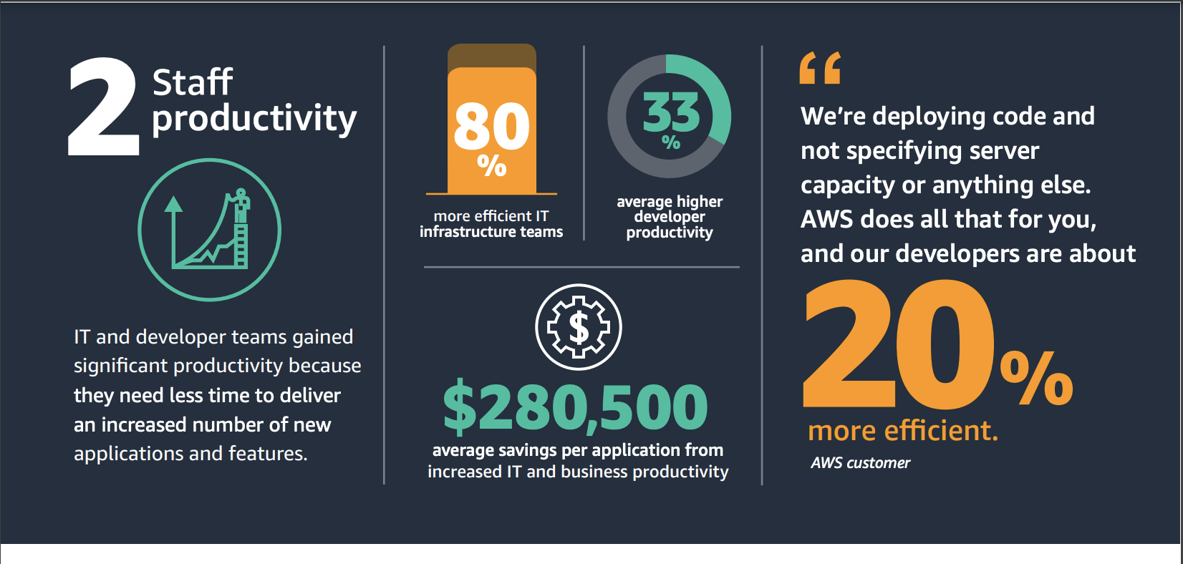
Serverless Benefits: AWS Reporting

Slide 37
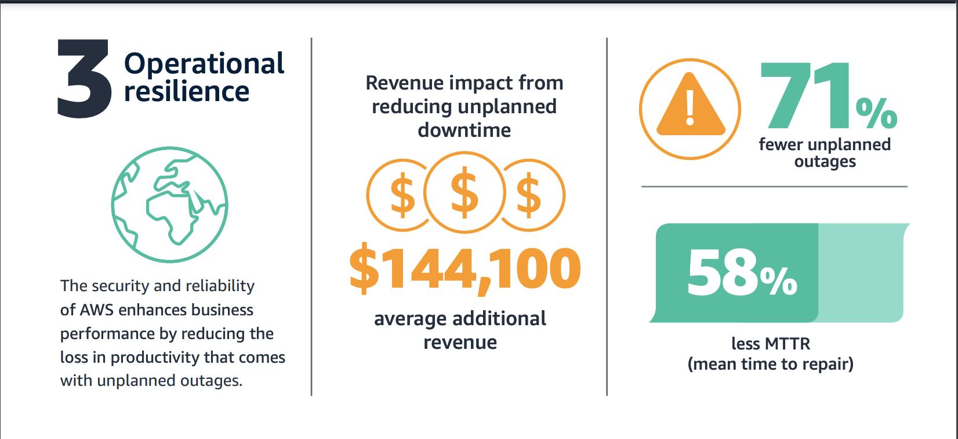
Serverless Benefits: AWS Reporting

Slide 38
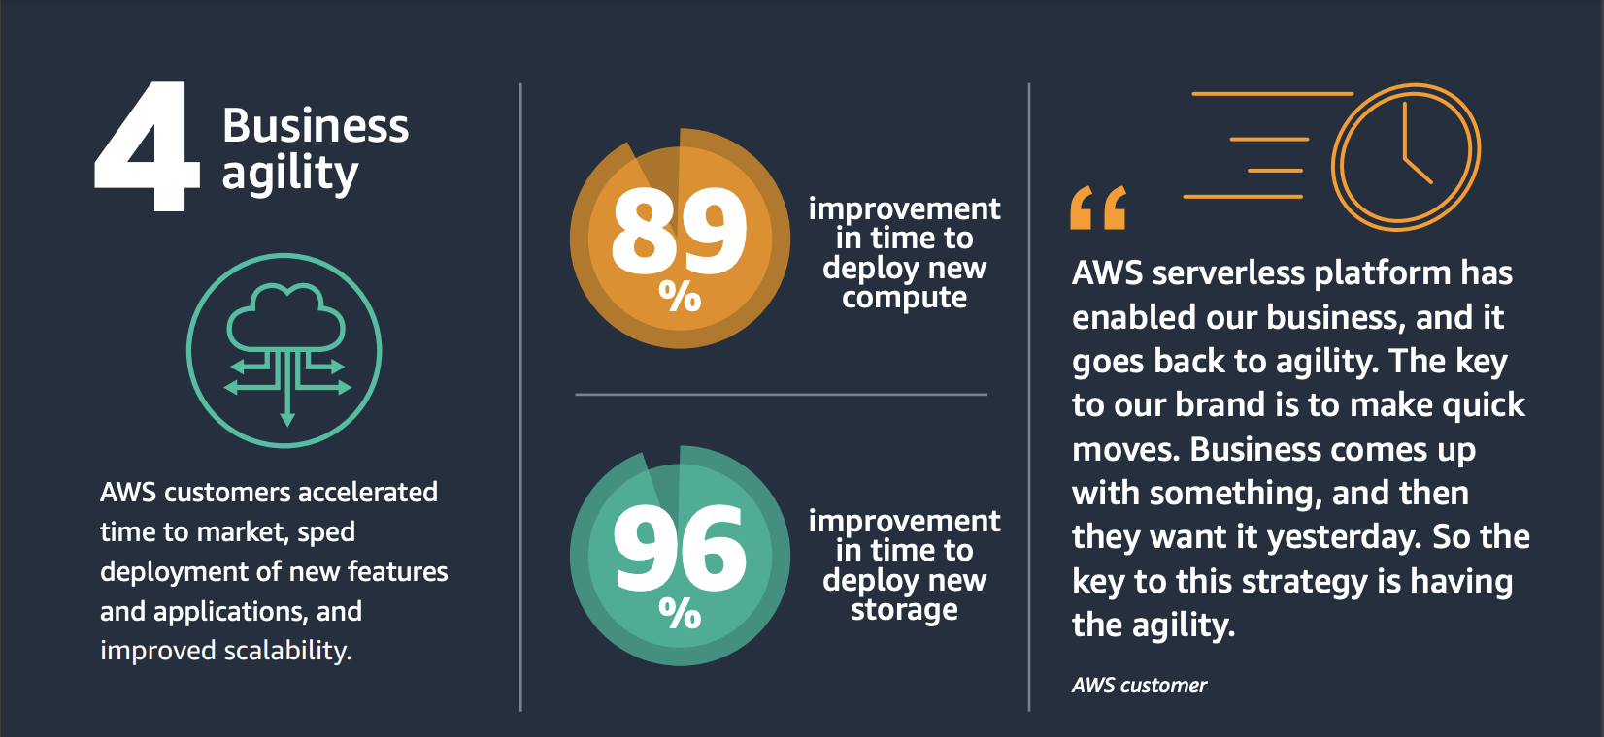
Serverless Benefits: AWS Reporting

Slide 39
Serverless Drawbacks
Vendor control
System downtime, unexpected limits, cost changes, loss of functionality, forced API upgrades
Vendor lock-in
Security concerns
Increased surface area for malicious intent
Repetition of logic across client platforms
Loss of server optimizations
Vendor rate limiting
Startup latency

Slide 40
Land Acknowledgement Statement
We respectfully acknowledge the University of Arizona is on the land and territories of Indigenous peoples. Today, Arizona is home to 22 federally-recognized tribes, with Tucson being home to the O’odham and the Yacqui. Committed to diversity and inclusion, the University strives to build sustainable relationships with sovereign Native Nations and Indigenous communities through education offerings, partnerships, and community service.

